Slide 1

Udacity A/B test overview
April 2021
Joun Bae

Slide 2
Table of contents
Background & Business Need
Experiment Overview
Experiment Design
Data Analysis & Results
Summary & Recommendations

Slide 3
1) Background & business need

Slide 4

background
This experiment is from Udacity’s A/B testing course by Google, and was an actual experiment that was run by Udacity.
The specific numbers were changed but the patterns have not. The experiment overview, metrics, and data are pre-defined and provided by Udacity.

Slide 5
Udacity’s Business need
Udacity is a for-profit educational company that provides online courses for professionals and students.
At the time of this experiment, Udacity had a paid version and free version of their services.
The paid version had benefits such as coaching support and verified certificates. Users could sign up for a 2-week free trial, and then were automatically charged unless canceled.
The free version included video and quiz access, but not the paid benefits.
Udacity wants to reduce enrollments that lead to cancellations (i.e. users who enrolled in paid version and canceled) due to frustrated students who don’t have enough time. This could lead to improved student experience and coaches’ capacity.

Slide 6
2) Experiment overview

Slide 7
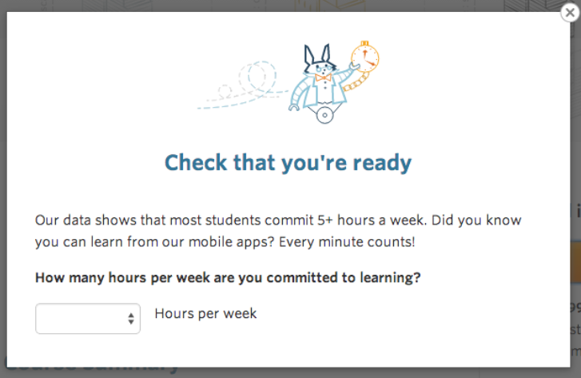
Current state vs. experiment
Current Experience
On the Udacity course overview page, there are two options: 1) "start free trial", and 2) "access course materials".
If user clicks "start free trial", they are asked for credit card information, and then enrolled in free trial of paid version.
If user clicks "access course materials", they access the free version.
Experiment Experience
If user clicks "start free trial", a pop-up will appear asking how much time they plan to commit.
If 5 + hours / week, user enrolls BAU.
If < 5 hours / week, the pop-up suggests the free option. Then, the student can continue to enroll, or access the free course instead.

Slide 8
The hypothesis
By setting clearer expectations on time commitment upfront, Udacity will:
Reduce the number of students enroll and leave the free trial because they didn't have enough time, and
Not change the number of students to continue past the free trial and eventually complete the course.

Slide 9
3) Experiment design

Slide 10
Evaluation Metrics
Metrics used to test hypothesis:
Expectations:
Gross conversion will decrease
Net conversion will stay the same
Definitions & Notes:
# of enrollments = User-ids to complete checkout and enroll in free trial
# of clicks = Unique cookies that clicked “Start free trial”
# of payments = User-ids enrolled past 14-day boundary and thus made at least one payment
Unit of diversion is cookie (i.e. how control vs. experiment groups are split)
1
View course page
2
Click “start free trial”
1
Gross conversion %
(Enrollments/Clicks)
Enrollment
2
Net conversion %
(Payments/Clicks)
Payment

Slide 11
Invariant metrics
Invariant metrics will be used to perform sanity checks on experiment set-up (i.e. they should not differ between control and experiment groups):
Metric Name | Definition / Calculation
Page views | # of unique cookies view course overview page
Enrollments | # of users who enroll in free trial
Clicks | # of unique cookies to click “Start free trial” button
Click-Thru-Probability (CTP) | # clicks / # page views

Slide 12
Sample size & duration
Baseline data used to determine experiment’s duration and sample size
Assuming 50% of traffic diversion to this experiment, experiment will be run for 35 days
Metric Name | Calculation | Baseline rate | Dmin | Alpha | 1-Beta | Traffic % | Sample Size (Page views) | Duration (days)
Gross Conversion | (# of enrollments) / (# of clicks) | 20.6% | 0.01 | 0.05 | 80% | 50% | 645,875 | 33
Net Conversion | (# of payments) / (# of clicks) | 10.9% | 0.0075 | 0.05 | 80% | 50% | 685,325 | 35

Slide 13
4) Data analysis & Results

Slide 14
Control and Experiment data
Summary metrics of data provided by Udacity:
Group | Sample size | Page views (per day) | Clicks (per day) | Enrollments (per day) | Payments (per day) | Gross Conversion | Net Conversion
Control | 23 days | 9339 | 767 | 164.6 | 88.4 | 21.46% | 11.53%
Experiment | 23 days | 9315 | 766 | 148.8 | 84.6 | 19.43% | 11.04%
Difference (control – exp) | 23 days | 24 | 1 | 15.8 | 3.8 | 2.03% | 0.48%
CAVEAT: The sample size Udacity provided is not large enough to determine statistical significance. In real life, the next steps would be 1) discuss enrollment data with engineers, and 2) wait 12 days to get 37 days of data. See appendix for more details.

Slide 15
Sanity checks
Sanity checks all passed for each invariant metric.
Metric Name | Null Hypothesis | Test Performed | Result | Pass Sanity Check?
Page views | Page views of control and experiment are equal | 2 sample t-test | Fail to reject null hypothesis; no statistical difference in control vs. experiment group | Yes
Enrollments | Enrollments of control and experiment are equal | 2 sample t-test | Fail to reject null hypothesis; no statistical difference in control vs. experiment group | Yes
Clicks | Enrollments of control and experiment are equal | 2 sample t-test | Fail to reject null hypothesis; no statistical difference in control vs. experiment group | Yes
Click-Thru-Probability (CTP) | CTP of control and experiment are equal | 2 sample z-test | Fail to reject null hypothesis; no statistical difference in control vs. experiment group | Yes

Slide 16
Hypotheses testing
Hypothesis 1 – Gross conversion
Null Hypothesis (H₀: µ₁ =µ₂)
Gross conversion is equal for users who received the new pop-up asking for time commitment vs. not
Alternative Hypothesis (H₁: µ₁ ≠ µ₂)
Gross conversion is not equal for users who received the new pop-up asking for time commitment vs. not
Hypothesis 2 – Net conversion
Null Hypothesis (H₀: µ₁ =µ₂)
Gross conversion is equal for users who received the new pop-up asking for time commitment vs. not
Alternative Hypothesis (H₁: µ₁ ≠ µ₂)
Gross conversion is not equal for users who received the new pop-up asking for time commitment vs. not

Slide 17
Testing results
Hypothesis | Result | Statistically significant? | Practically Significant? | Aligns with expectation? | 95% Confidence interval
1 – Gross Conversion | Reject null | Yes | Yes | Yes – gross conversion is lower | -0.0291 to -0.0120
2 – Net Conversion | Fail to reject | No | No | Yes – no significant change, but experiment was lower | -0.0116 to 0.0019
At a p-value < 0.01, we reject our null hypothesis that gross conversion is equal. The gross conversion for the experiment group is 0.0206 lower than control (95% CI: -0.0291 to -0.0120).
At a p-value > 0.05, we fail to reject our null hypothesis that net conversion is equal. The gross conversion difference of -0.0049 for users who received the pop-up vs. is not statistically significant (CI: -0.0116 to 0.0019).

Slide 18
5) Summary & recommendations

Slide 19
Summary & recommendation
The results aligns with the hypothesis that showing the pop up will reduce the churn in users, while not impacting users who ultimately stay.
Gross conversion: The experiment group gross conversion is lower at a statistically and practically significant level.
Net conversion: While the difference is not statistically significant, the net conversion for the experiment group was lower than the control group.
The recommendations:
Do not expand the experiment. Rerun analysis after 14 days for sufficient sample size.
Run other experiments that may lead to better outcomes. While not statistically significant, the experiment group had lower net conversion, which is not desirable for a for-profit company.

Slide 20
Other potential experiments
Test decrease in gross conversion by adding disclaimer under "start new trial" that indicates recommended time commitment.
This may better set expectations, while not potentially negatively impacting net conversion.
Test increase net conversion by reminding users to spend time on course (e.g. “You've spent 2 hours this week vs. the recommended time of 5. Continue learning now!").
This may increase engagement and thus retention.
1
View course page
Click “start free trial”
1
Gross conversion %
(Enrollments/Clicks)
2
Enrollment
2
Net conversion %
(Payments/Clicks)
Payment

Slide 21
Appendix

Slide 22
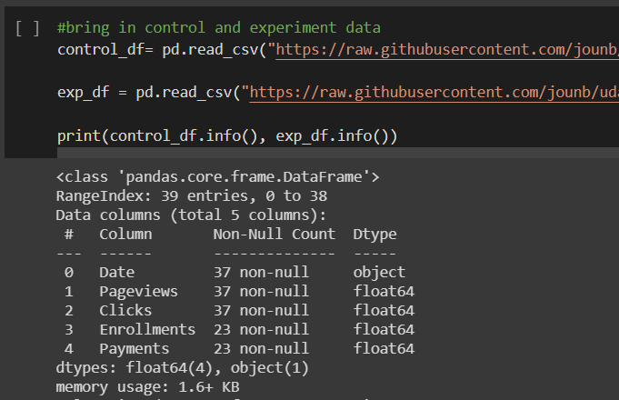
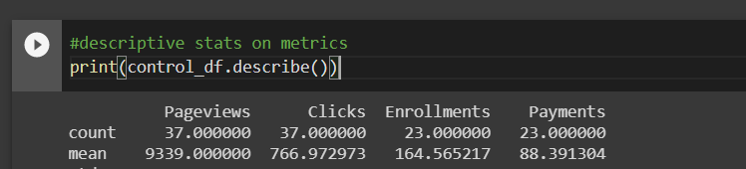
Data issues
Following issues identified from Udacity data:
Only 23 days of full data were provided. Given the daily page views in the control and experiment group were ~9300 and the total daily page views are 40,000, we can assume Udacity also diverted 50% of the traffic. In that case, the needed sample size for gross conversion is 32 days, and net conversion is 34 days. Only 23 days of full data were provided.
14 days of data missing for Enrollments. The missing payments are due to the 14 day wait period, but enrollment data should be available for the full period.
Potentially, enrollments are users who stayed enrolled for 14 days, which is not what we need for gross conversion
In real life, next steps would be 1) discuss availability and definition of enrollment data with engineers, and 2) wait 14 days to gather a sufficient sample size.
However, in order to continue the analysis, N/As were dropped.

